Slide 1

Chapter 24
Network Management:
SNMP
Copyright © The McGraw-Hill Companies, Inc. Permission required for reproduction or display.

Slide 2
OBJECTIVES:
To discuss SNMP as a framework for managing devices in an internet using the TCP/IP protocol suite.
To define a manager as a host that runs SNMP client and any agents as a router or host that runs a server program.
Discuss SMI and MIB, which are used by SNMP.
To show how SMI names objects, defines the type of data, and encodes data.
To show how data types are defined using ASN.1.
To show how SMI uses BER to encode data.
To show the functionality of SNMP using three methods.

Slide 3
OBJECTIVES:
To show how SNMP uses two different ports of UDP.
To show how SNMPv3 has enhanced security features over previous versions.

Slide 4
Chapter
Outline
24.1 Concept
24.2 Management Components
24.3 SMI
24.4 MIB
24.5 SNMP
24.6 UDP Ports
24.7 Security

Slide 5
24-1 CONCEPT
SNMP uses the concept of manager and agent. That is, a manager, usually a host, controls and monitors a set of agents, usually routers or servers (see Figure 24.1).

Slide 6
Topics Discussed in the Section
Managers and Agents

Slide 7
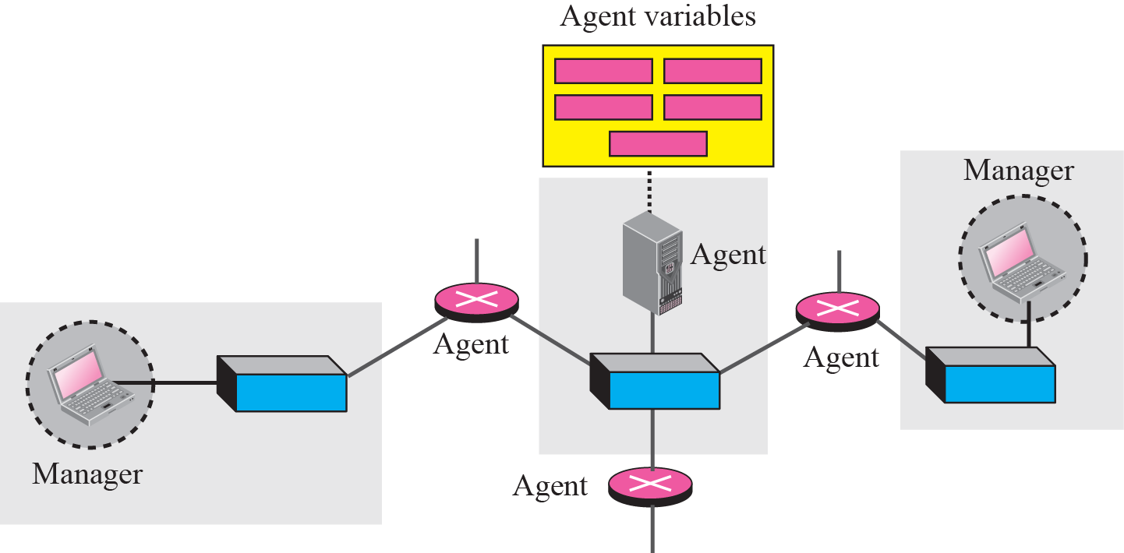
Figure 24.1 SNMP concept

Slide 8
24-2 MANAGEMENT COMPONENTS
To do management tasks, SNMP uses two other protocols: Structure of Management Information (SMI) and Management Information Base (MIB). In other words, management on the Internet is done through the cooperation of three protocols: SNMP, SMI, and MIB, as shown in Figure 24.2.

Slide 9
Topics Discussed in the Section
Role of SNMP
Role of SMI
Role of MIB
An Analogy
An Overview

Slide 10
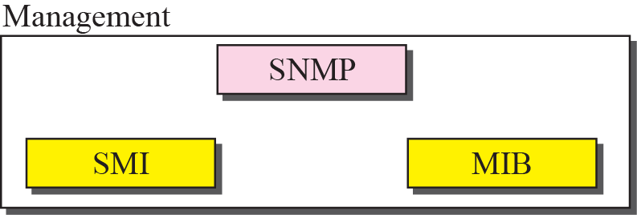
Figure 24.2 Companion of network management on the Internet

Slide 11

Note
SNMP defines the format of packets exchanged between a manager and an agent. It reads and changes the status of objects (values of variables) in SNMP packets.

Slide 12
Note
SMI defines the general rules for naming objects, defining object types (including
range and length), and showing how to encode objects and values.

Slide 13
Note
MIB creates a collection of named objects, their types, and their
relationships to each other in an entity to be managed.

Slide 14
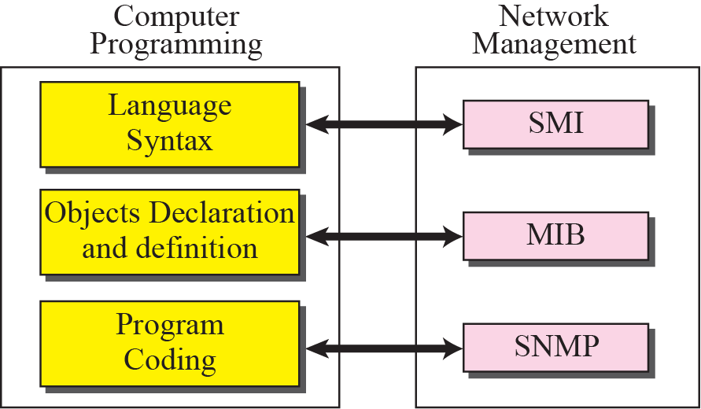
Figure 24.3 Comparing computer programming and network management

Slide 15
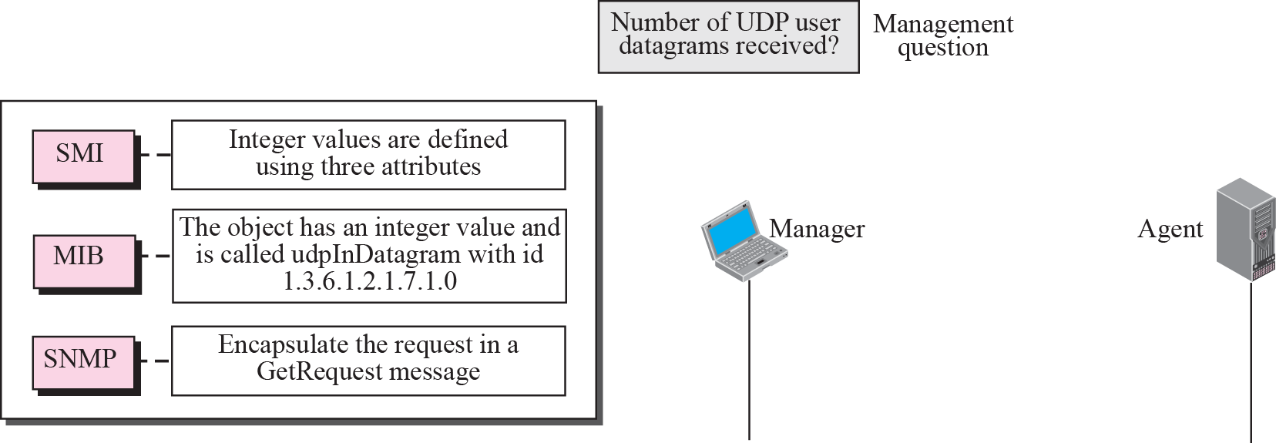






Figure 24.4 Management overview

Slide 16
24-3 SMI
The Structure of Management Information is a component for network management. Its functions are:
1. To name objects.
2. To define the type of data that can be stored in an object.
3. To show how to encode data for transmission
over the network.
SMI is a guideline for SNMP. It emphasizes three attributes to handle an object: name, data type, and encoding method.

Slide 17
Topics Discussed in the Section
Name
Type
Encoding Method

Slide 18
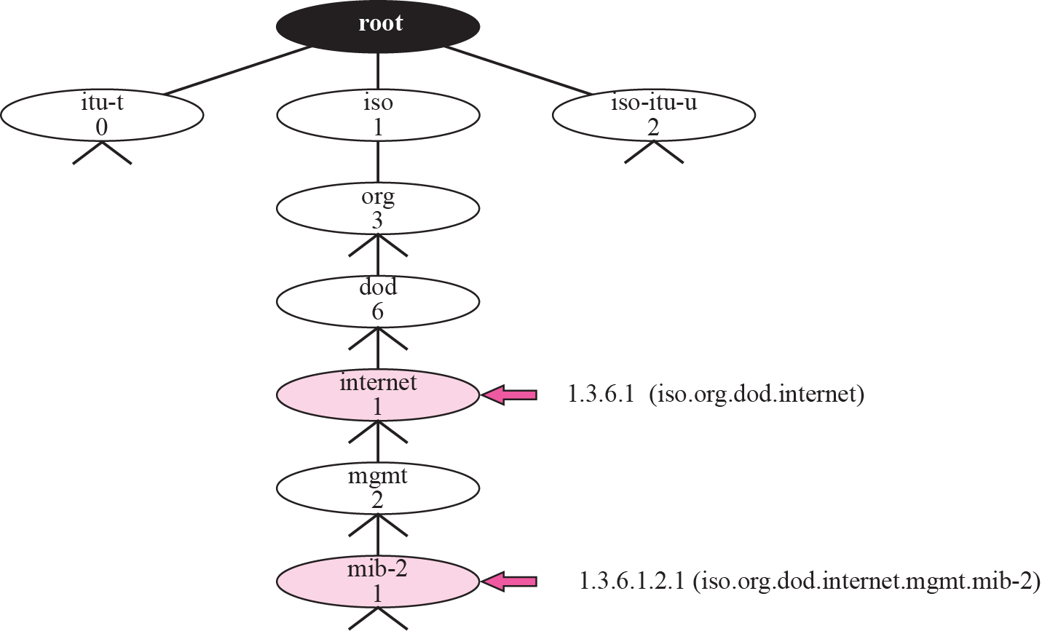
Figure 24.5 Object identifier

Slide 19
Note
All objects managed by SNMP are given an object identifier.
The object identifier always starts with 1.3.6.1.2.1.

Slide 20
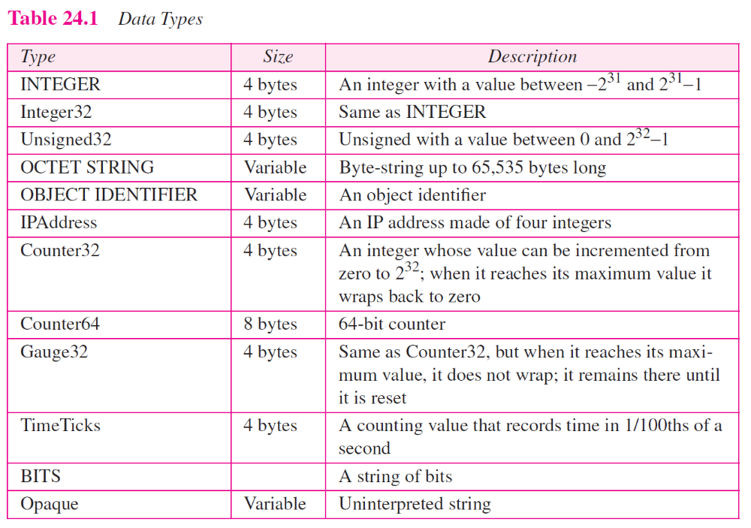

Slide 21
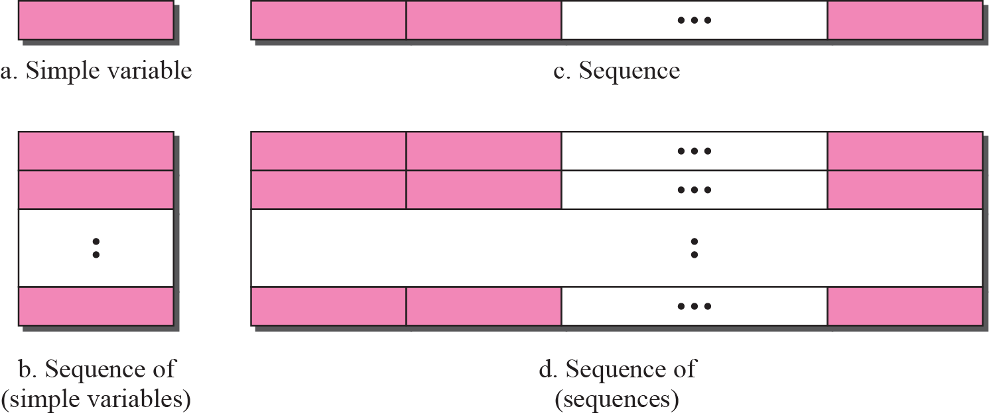
Figure 24.6 Conceptual data types

Slide 22
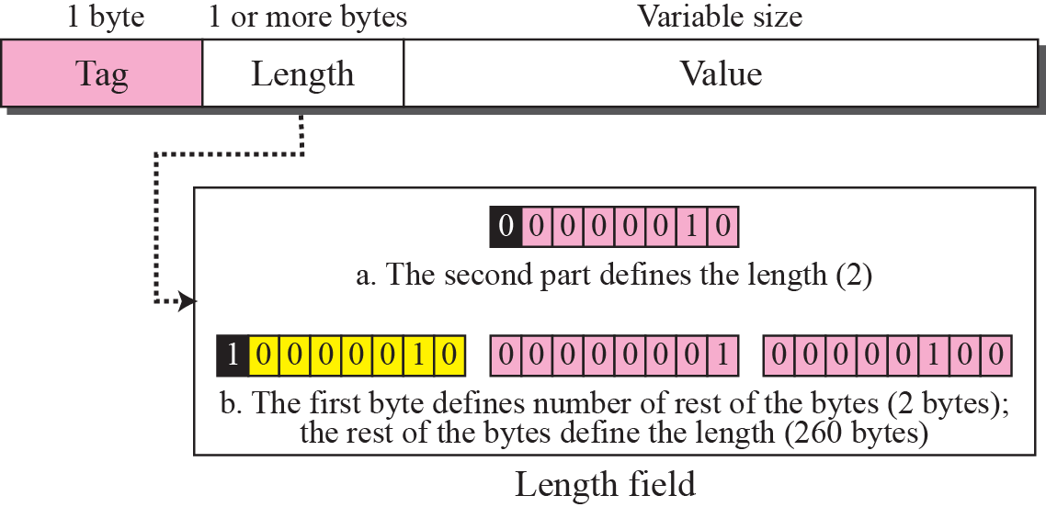
Figure 24.7 Encoding format

Slide 23
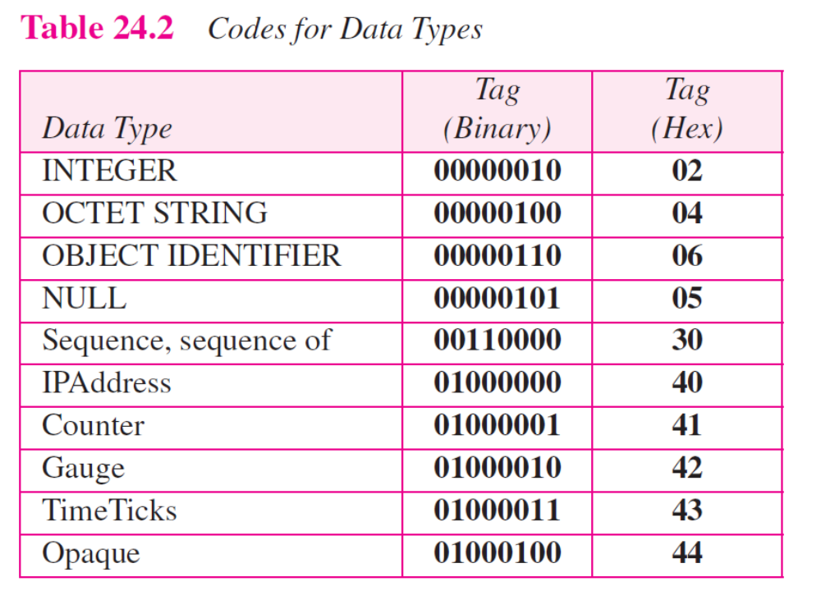

Slide 24
Example 24.1
Figure 24.8 shows how to define INTEGER 14. Note that we have used both binary representation and hexadecimal representation for the tag. The size of the length field is from Table 24.1.

Slide 25
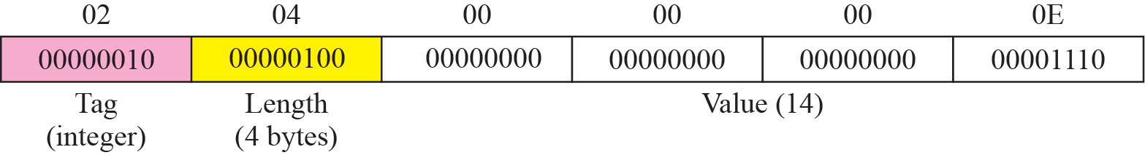
Figure 24.8 Example 24.1: INTEGER 14

Slide 26
Example 24.2
Figure 24.9 shows how to define the OCTET STRING “HI.”

Slide 27
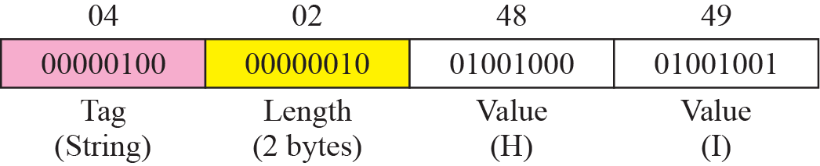
Figure 24.9 Example 24.2: OCTET STRING “HI”

Slide 28
Example 24.3
Figure 24.10 shows how to define ObjectIdentifier 1.3.6.1 (iso.org.dod.internet).

Slide 29
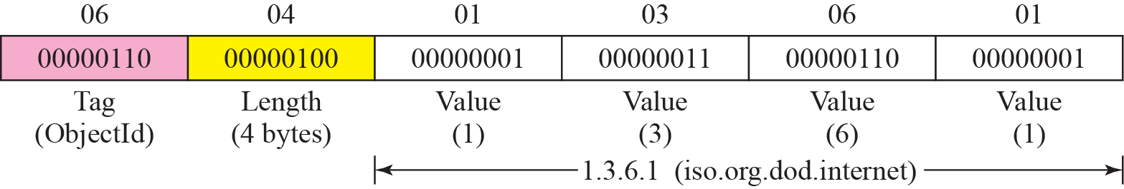
Figure 24.10 Example 24.3: ObjectIndentifier 1.3.6.1

Slide 30
Example 24.4
Figure 24.11 shows how to define IPAddress 131.21.14.8.

Slide 31
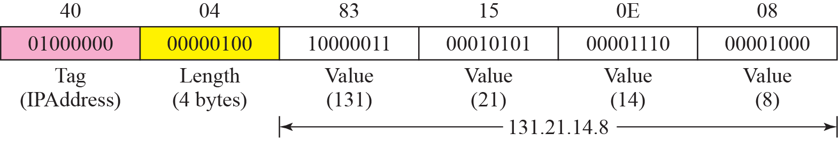
Figure 24.11 Example 24.4: IPAddress 131.21.14.8

Slide 32
24-4 MIB
The Management Information Base, version 2 (MIB2) is the second component used in network management. Each agent has its own MIB2, which is a collection of all the objects that the manager can manage. The objects in MIB2 are categorized under 10 different groups: system, interface, address translation, ip, icmp, tcp, udp, egp, transmission, and snmp. These groups are under the mib-2 object in the object identifier tree (see Figure 24.12). Each group has defined variables and/or tables.

Slide 33
Topics Discussed in the Section
Accessing MIB Variables
Lexicographic Ordering

Slide 34
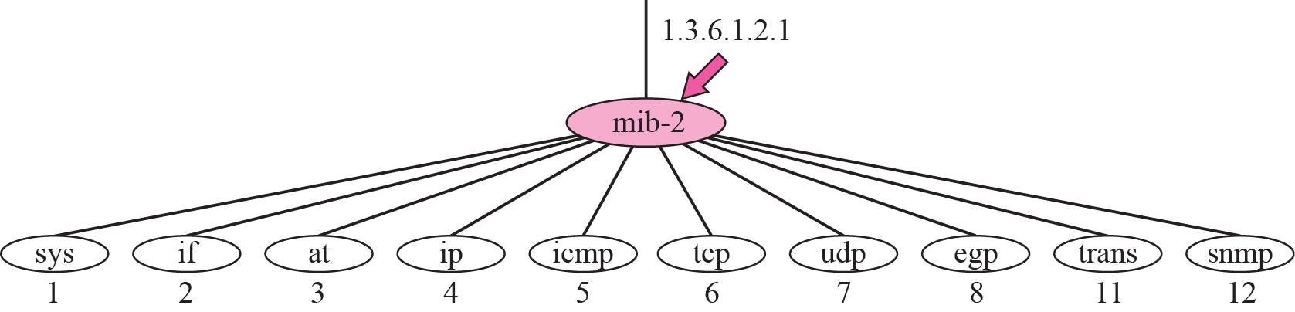
Figure 24.12 mib-2

Slide 35
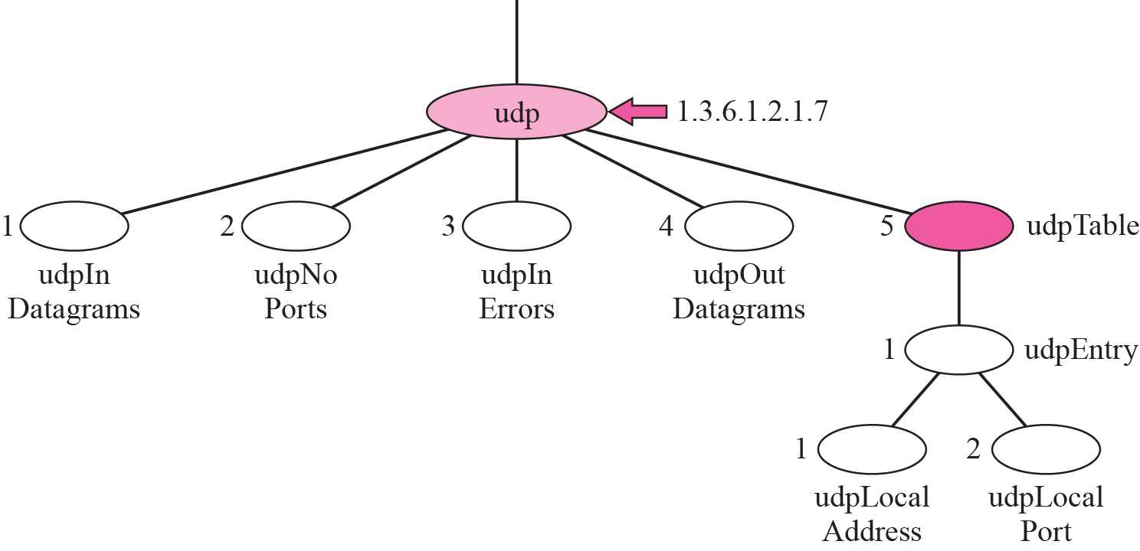
Figure 24.13 udp group

Slide 36
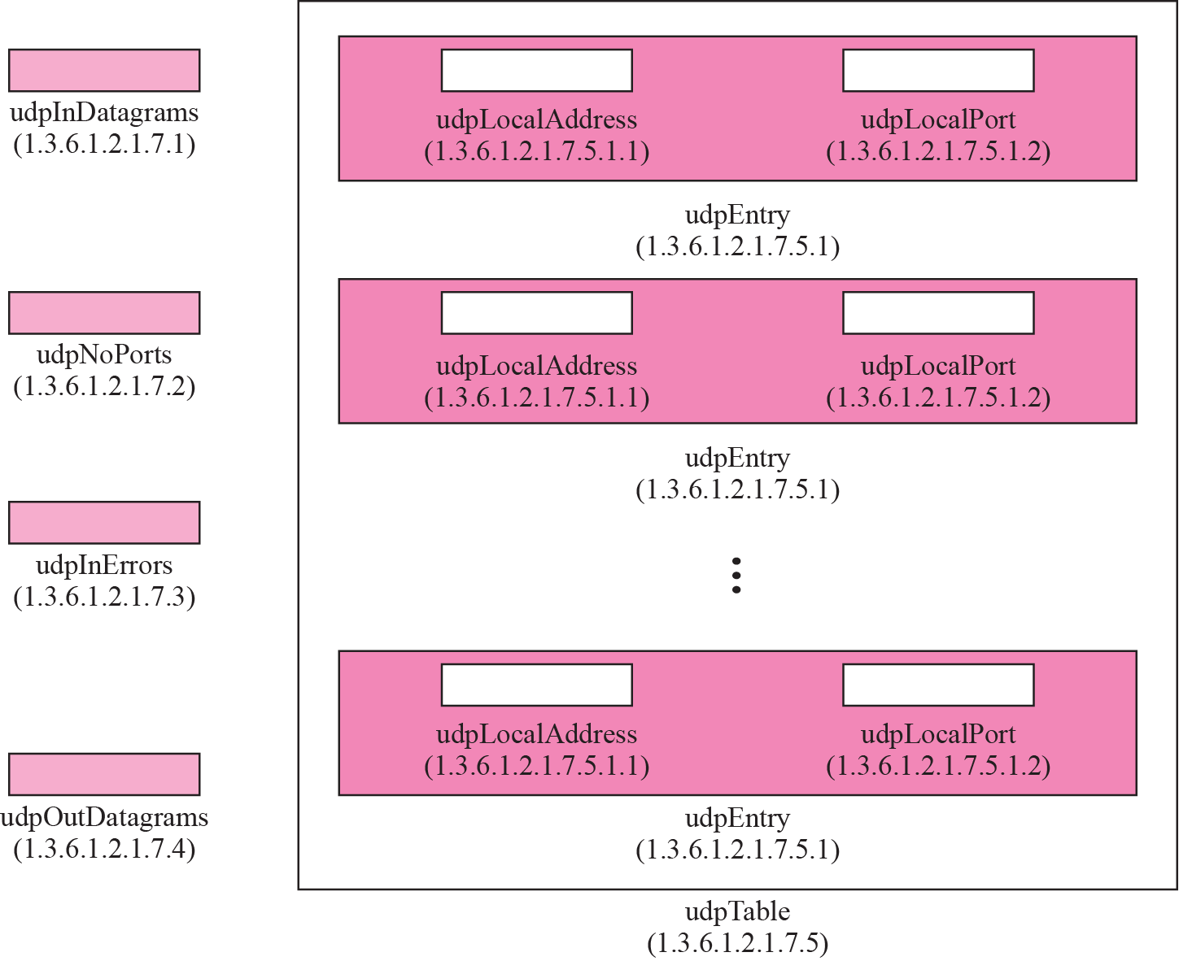
Figure 24.14 udp variables and tables

Slide 37
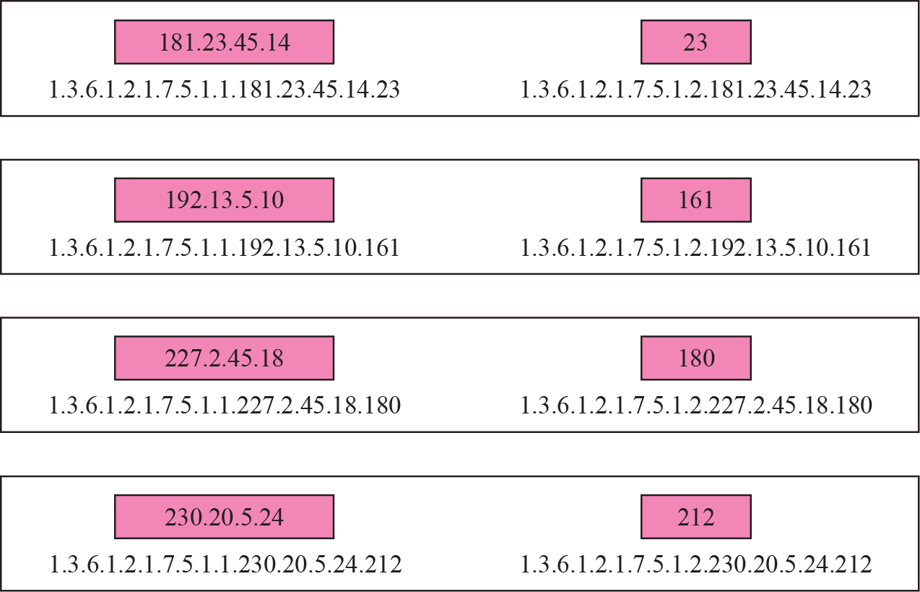
Figure 24.15 Indexes for udpTable

Slide 38
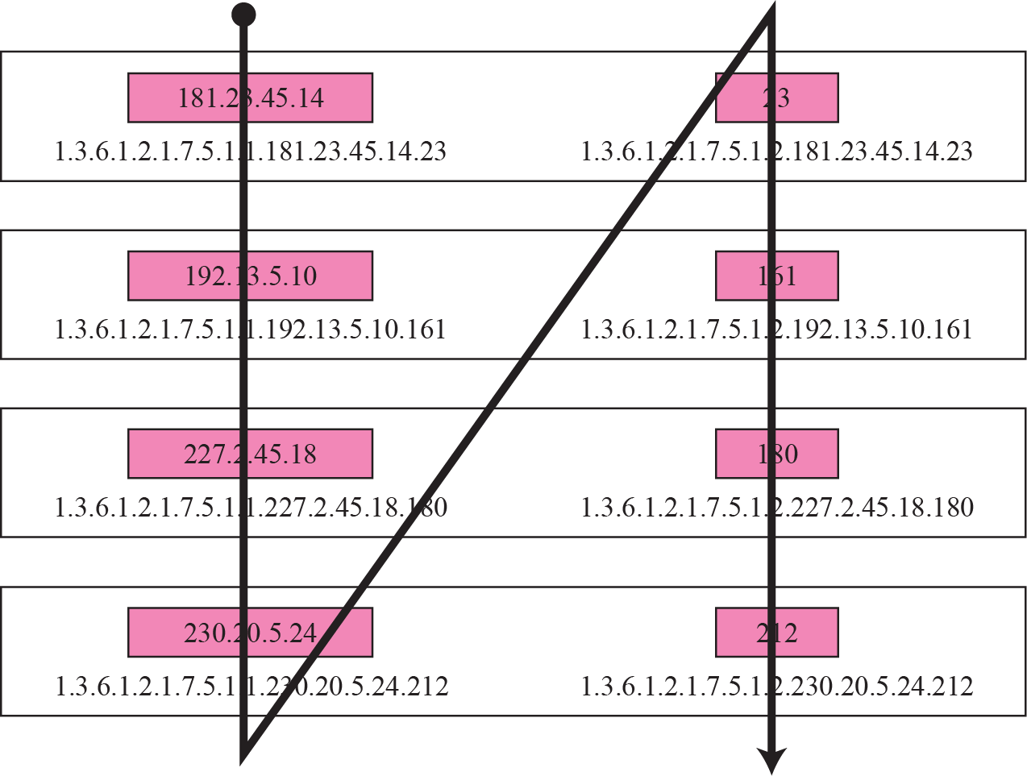
Figure 24.16 Lexicographic ordering

Slide 39
24-5 SNMP
SNMP uses both SMI and MIB in Internet network management. It is an application program that allows:
1. A manager to retrieve the value of an object defined in an agent.
2. A manager to store a value in an object defined in an agent.
3. An agent to send an alarm message about an abnormal situation to the manager.

Slide 40
Topics Discussed in the Section
PDUs
Format
Messages

Slide 41
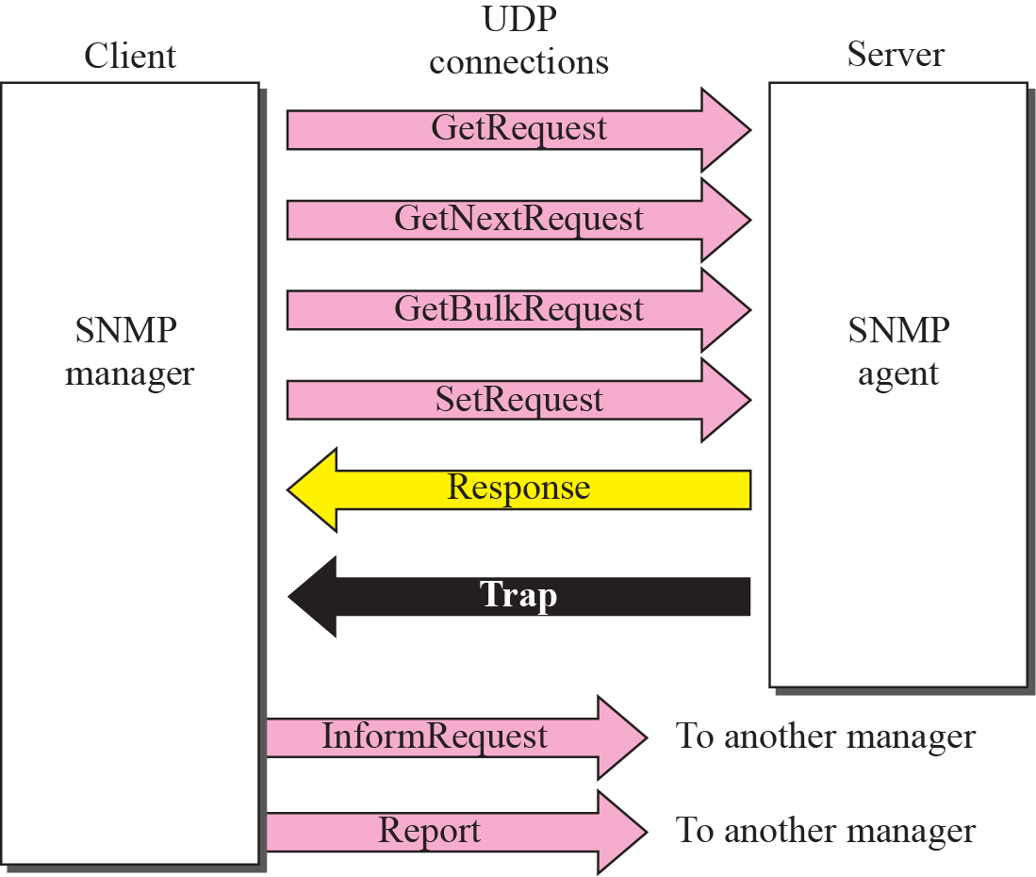
Figure 24.17 SNMP PDUs

Slide 42
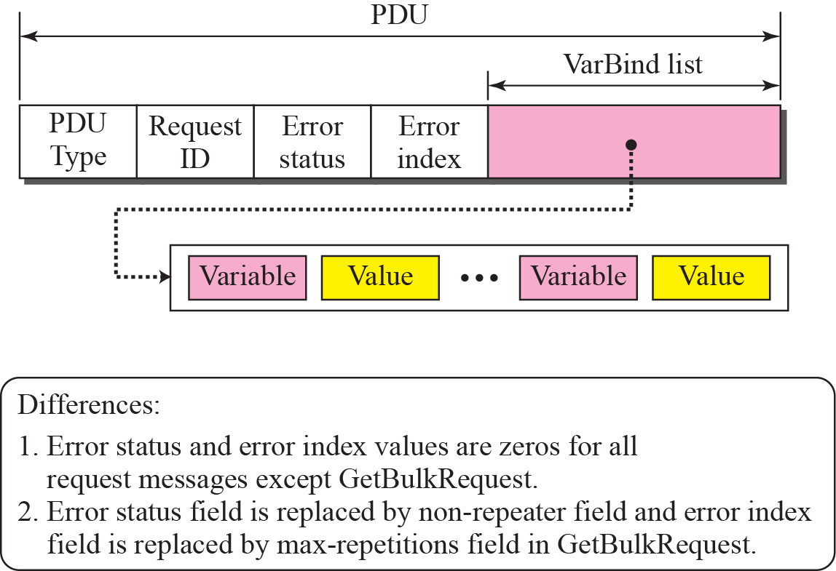
Figure 24.18 SNMP PDU format

Slide 43
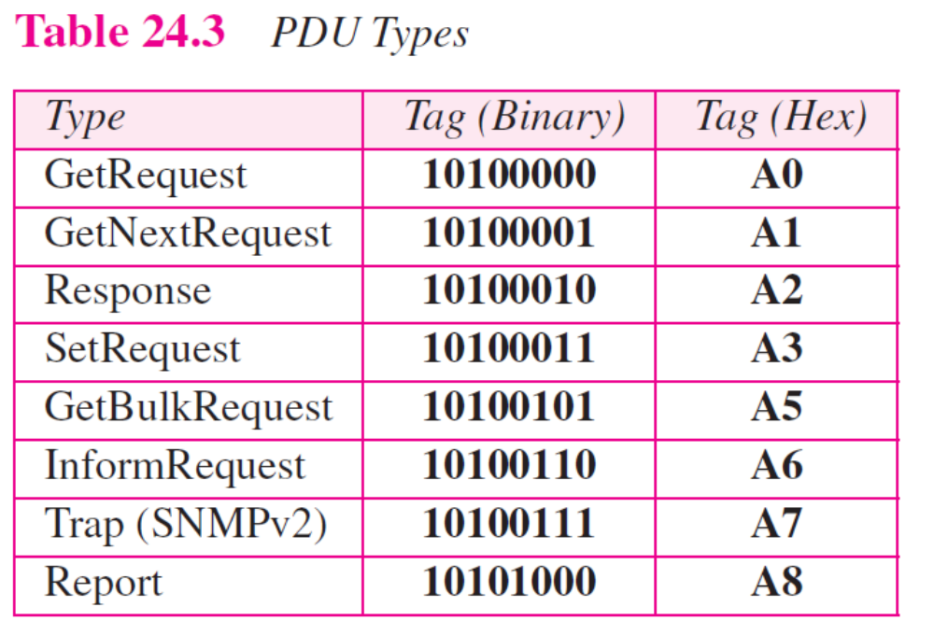

Slide 44
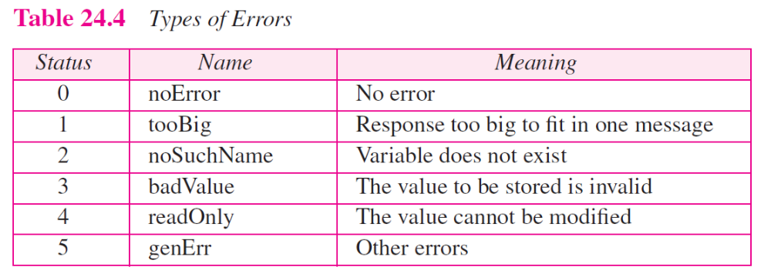

Slide 45
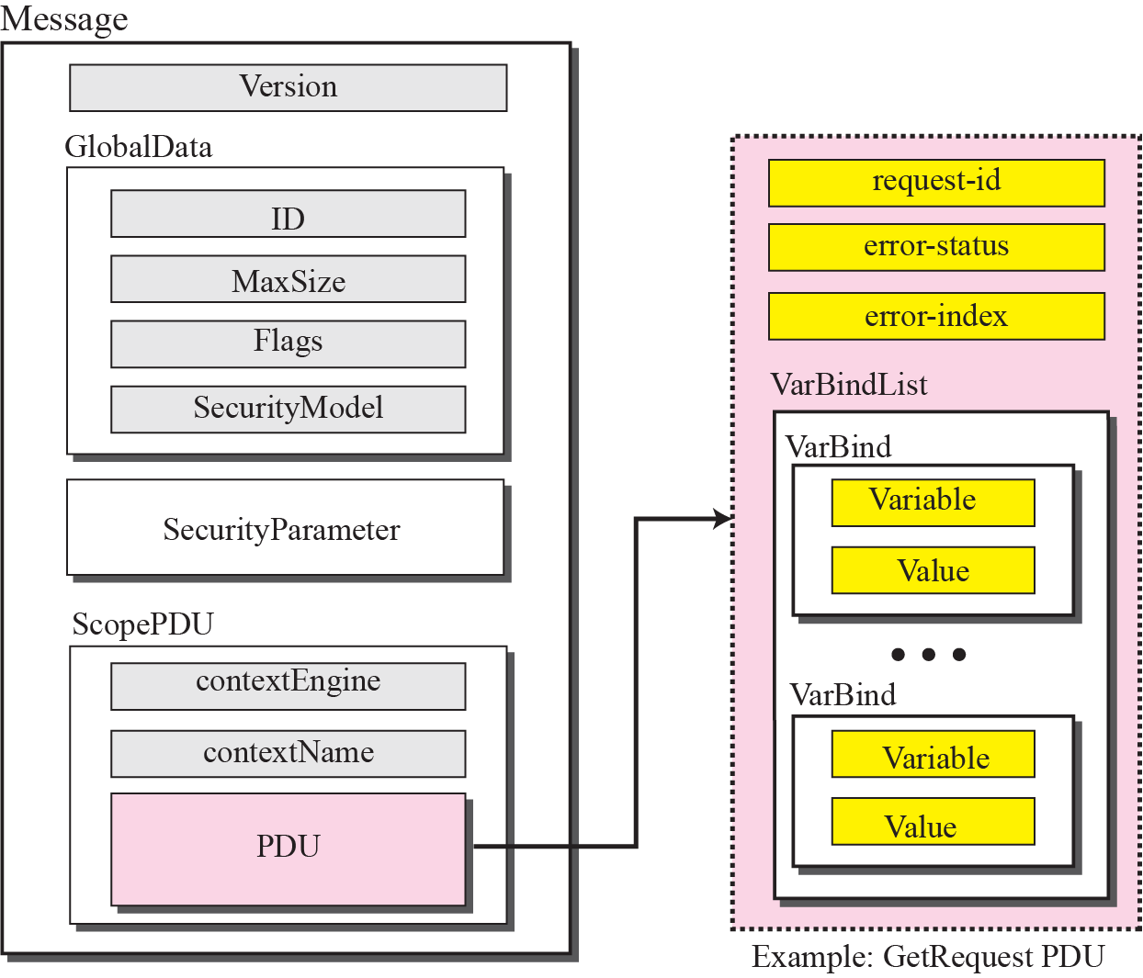
Figure 24.19 SNMP message

Slide 46
Example 24.4
In this example, a manager station (SNMP client) uses a message with GetRequest PDU to retrieve the number of UDP datagrams that a router has received (Figure 24.20). There is only one VarBind sequence. The corresponding MIB variable related to this information is udpInDatagrams with the object identifier 1.3.6.1.2.1.7.1.0. The manager wants to retrieve a value (not to store a value), so the value defines a null entity. The bytes to be sent are shown in hexadecimal representation.

Slide 47
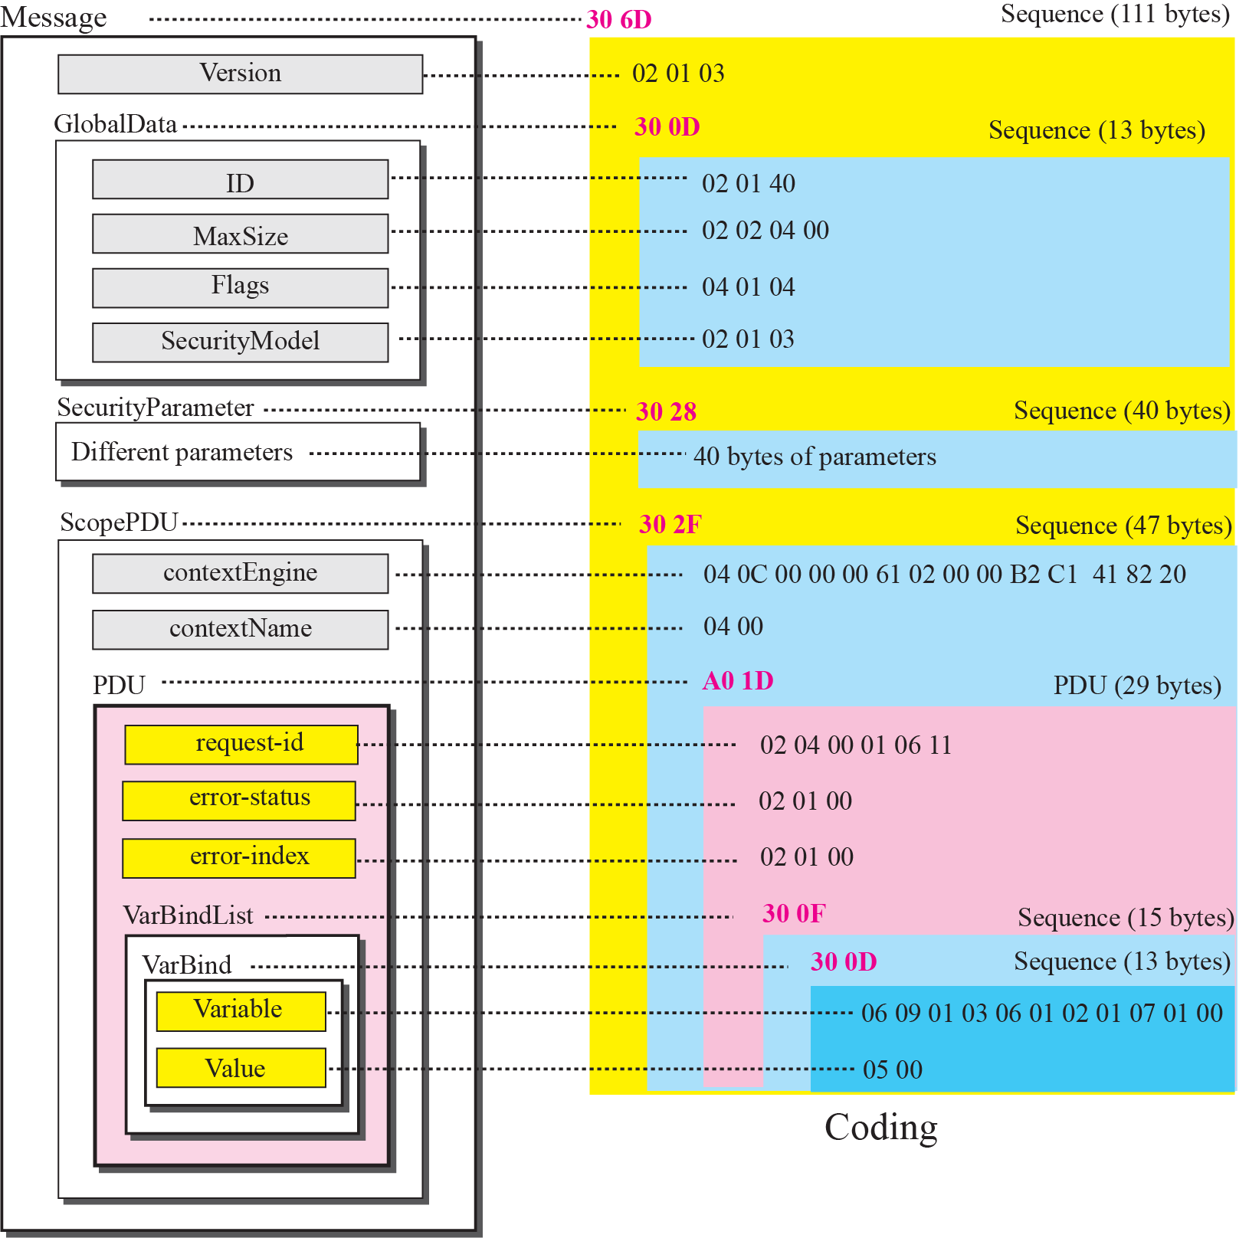
Figure 24.20 Example 24.5

Slide 48
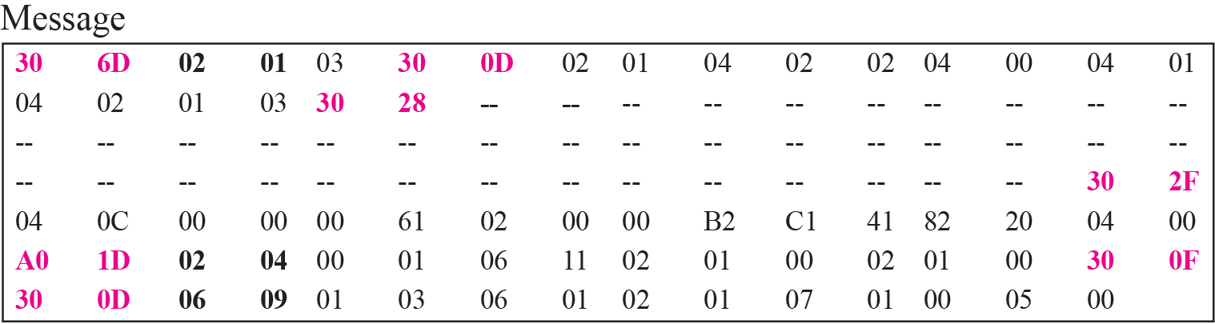
Figure 24.21 Actual message sent for Example 24.5

Slide 49
24-6 UDP PORTS
SNMP uses the services of UDP on two well-known ports, 161 and 162. The well-known port 161 is used by the server (agent), and the well-known port 162 is used by the client (manager).

Slide 50
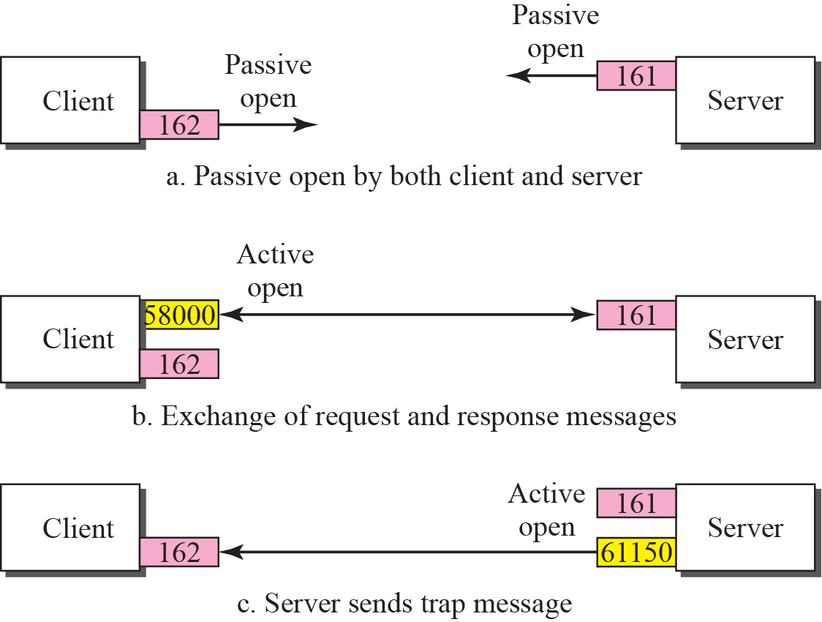
Figure 24.2 Port numbers for SNMP

Slide 51
24-7 SECURITY
SNMPv3 has added two new features to the previous version: security and remote administration. SNMPv3 allows a manager to choose one or more levels of security when accessing an agent. Different aspects of security can be configured by the manager to allow message authentication, confidentiality, and integrity.
SNMPv3 also allows remote configuration of security aspects without requiring the administrator to actually be at the place where the device is located.

